Slide 1
Progress Report
Weeks 1 - 2
HARSH GUPTA

Slide 2
Outline:
Theoretical Concepts
Tools, libraries, frameworks
Practical Implementations
Project: Stock Price Prediction
Next Steps

Slide 3
Theoretical Concepts:
Regression: linear, logistic
Support Vector Machine: linear
Decision Trees
Random Forest
Gradient Boosting: XGBoost
Evaluation Metrics: Accuracy, MAE(Mean Absolute Error), RMSE(Root Mean Squared Error)

Slide 4
Courses Taken
1. 100 Days Of Machine Learning by GeeksForGeeks
2. Python - Kaggle
3. Introduction to Machine Learning - Kaggle
4. Intermediate Machine Learning - Kaggle

Slide 5
Tools, Libraries & Frameworks
Numpy, Pandas (Data Processing)
Matplotlib (Data Visualization)
Scikit-Learn
Jupyter Notebook, VS Code - Tools
Streamlit - Deployment Cloud

Slide 6

Stock Price Prediction Using Machine Learning
Development and Deployment

Slide 7

Sections
Problem Statement
Objectives
Dataset Description
ML Models Implemented
Model Implementation
Evaluation Metrics
Results and Performance
Challenges & Solutions
Conclusions and Q&A

Slide 8
Problem Statement
Stock prices are influenced by multiple unpredictable factors
High volatility makes accurate prediction extremely difficult
Traditional methods have limited processing capabilities
Manual analysis is time-consuming and error-prone
Human bias affects decision-making processes
Inability to process large datasets efficiently
Lack of real-time prediction capabilities
Poor investment decisions lead to financial losses
Missed opportunities due to delayed analysis
Inability to adapt to rapid market changes
Limited accessibility to advanced prediction tools
The Challenge
Limitations
Impact

Slide 9

Objectives
Primary Goal:
To develop an accurate and reliable machine learning model capable of predicting future stock prices based on historical data
Secondary Goals:
Create user-friendly interface for predictions
Compare multiple ML algorithms performance
Deploy model for real-time predictions

Slide 10

Dataset Description
Dataset Source: Kaggle
Features: Open Price, Close Price, Low Price, High Price, Volume, Adjusted Close Price, Market_Cap
Target Variable: Close Price
Data Size: 3494 rows
Training Data: 80% of Data Size
Testing Data: 20% of Data Size

Slide 11
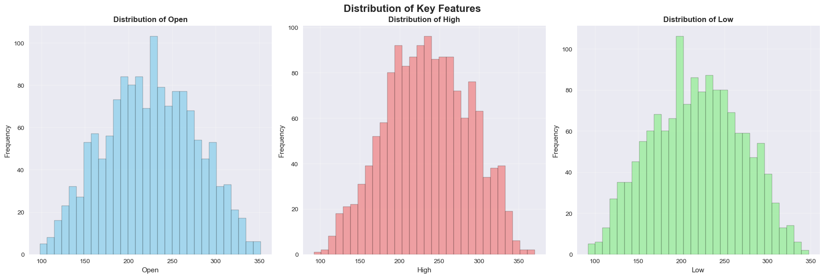
Key Features Distribution

Slide 12
Machine Learning Models Implemented
Linear Regression:
statistical method to model the relationship between stock prices and time
Assumes a linear relationship between input features and the target stock price.
Linear SVM:
finds the optimal hyperplane for regression.
Effective for high-dimensional data and avoids overfitting
Decision Tree:
non-linear model that splits the data based on feature values to make predictions.

Slide 13
Evaluation Metrics
R² Score -
R² = 1: Perfect prediction
R² = 0: Model does no better than the mean.
R² < 0: Model is worse than simply predicting the mean of the data.
RMSE(Root Mean Squared Error)
MAE(Mean Absolute Error)
MPAE(Mean Absolute Percentage Error)

Slide 14
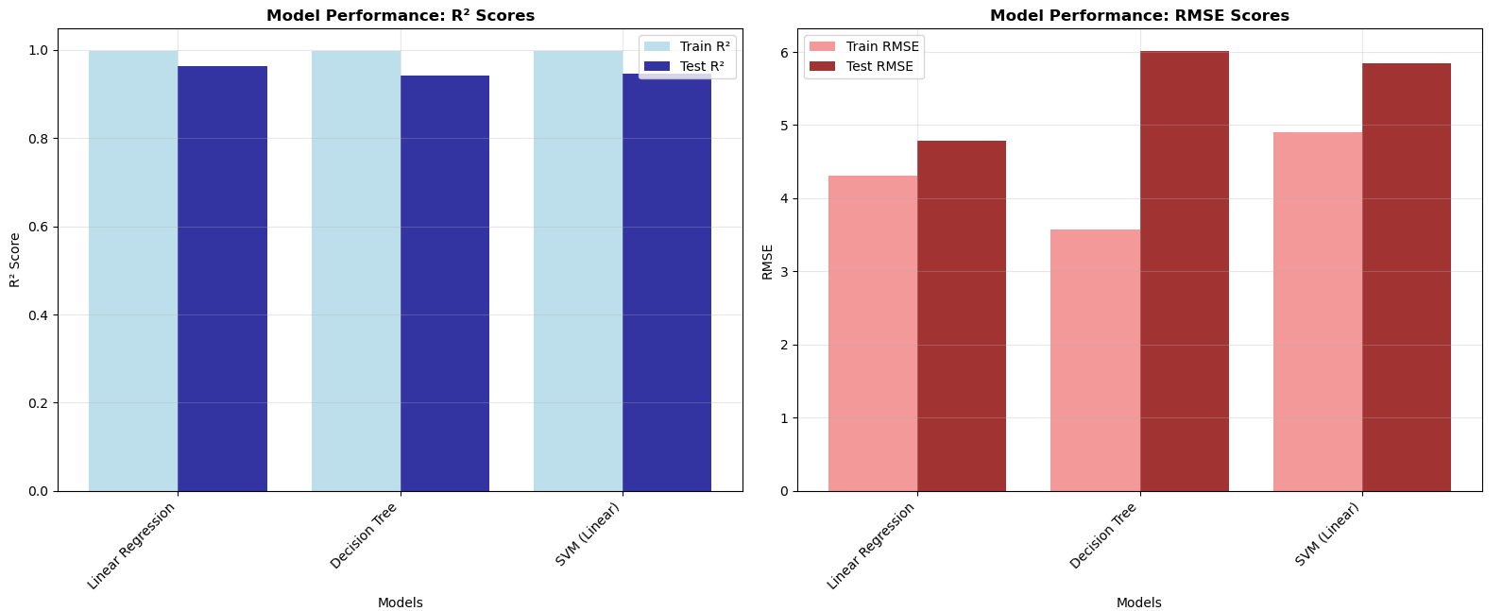
Results and Performance Comparison

Slide 15
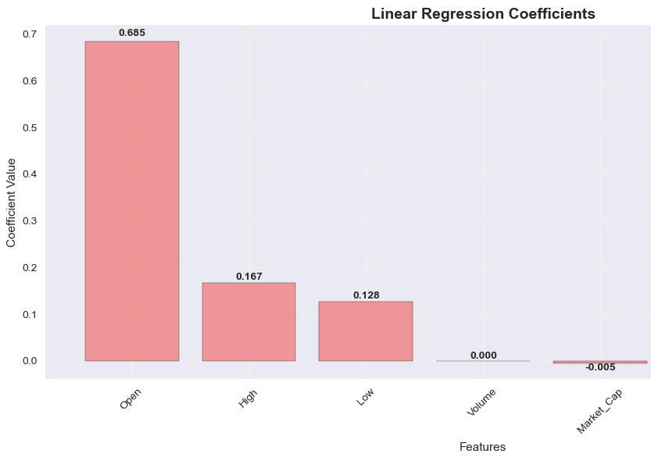
Feature Importance (linear regression)
Open Price: 0.685
High Price: 0.167
Low Price: 0.128
Market_Cap: -0.05
Volume: 0.000

Slide 16
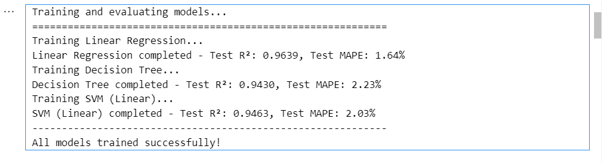
Model Results

Slide 17
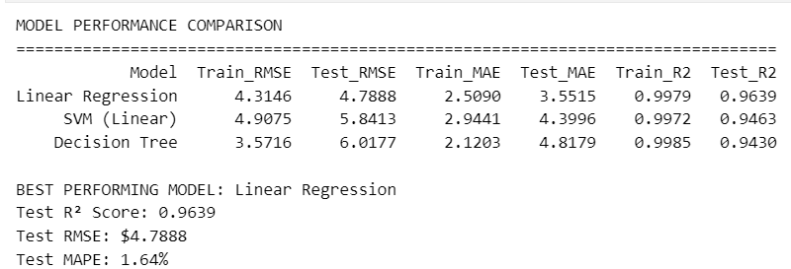
Model Performance Comparison

Slide 18
Challenges Faced
Data Anomalies:
Missing Data has to be removed
Outliers have to be checked
Data Leakage:
Data leakage can cause model to perform exceptionally well
It can be checked using multiple 1s in correlation matrix
R² score can be misleading due to high volatility in stock prices

Slide 19
Conclusions for Project:
Built 3 ML models:
linear regression, linear SVR, decision tree
Linear Regression has performed the best with accuracy of 96.39% for linear trends
Decision Tree performs for non-linear relationships with accuracy of 94.30%
Avoided Data leakage that resulted in unexpectedly increased accuracy

Slide 20
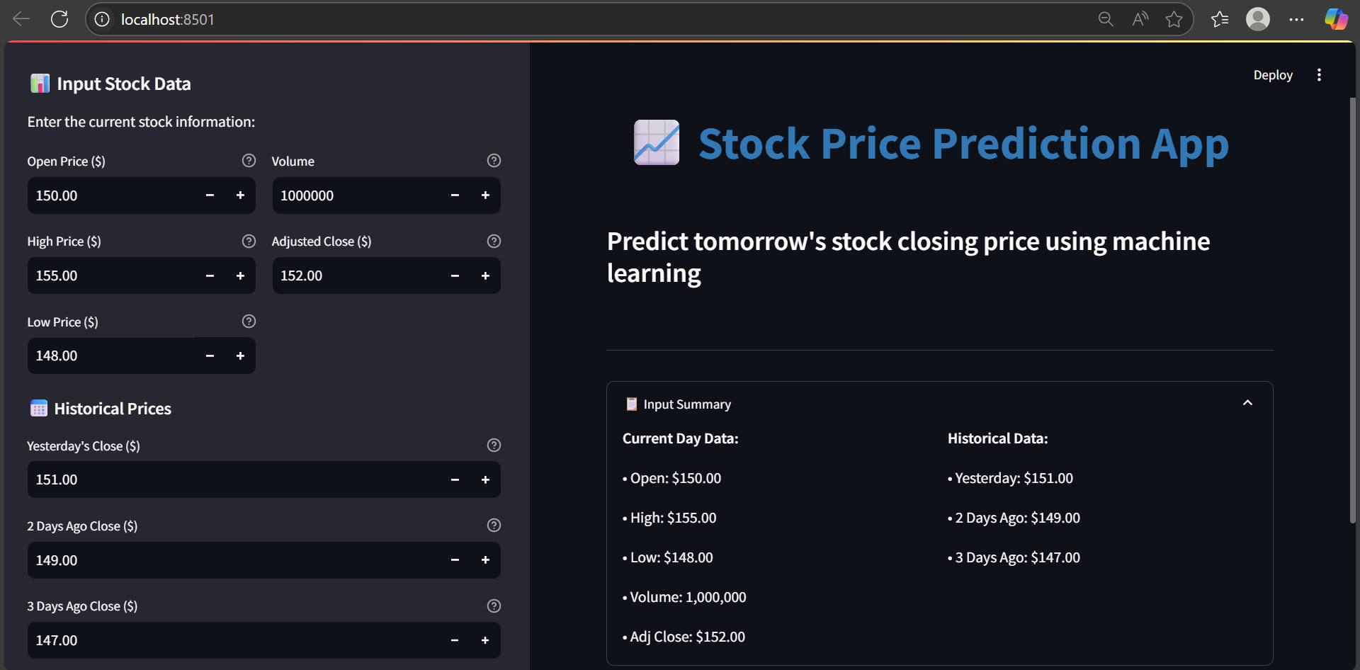
Deployment
Deployed On Streamlit

Slide 21
Further Steps:
Introduction To Deep learning – GFG
Generative AI & LLMs –
Hugging face Agents course

Slide 22
Thank You
—---------------------------------------------------------------------------------

